Slide 1
Ecommerce Website
Project Guide - Prof. Irfan Khatik
Submitted by :
Rakshita Singh(21549)
Neha Sirmagadum(21513)
Snehal Jadhav(21559)

Slide 2
Objective
The main objective of the project is to learn and implement a real-time application on database for Ecommerce. The Project concentrates on taking order, Shipping the order and maintaining the all details of payment and information of products, customer. The Primary goal of ecommerce is to reach maximum customers at the right time to increase sales and profitability of the business. Ecommerce drives profitable growth by expanding customer reach, reducing cost-to-serve, and creating differentiated customer experiences.

Slide 3
Features
Providing single platform to the customer for various type of Products.
Providing Payment Gateway.
User can visit the site and add the items to cart and checkout without needing to create an account.
Customer can order many times and also order same product many time by incrementing count.
Administrator can track the details of customer.
Administrator can also track the details of unauthenticated customer.

Slide 4
Django framework
How does Django Work?
Django follows the MVT design pattern (Model View Template).
Model - The data you want to present, usually data from a database.
View - A request handler that returns the relevant template and content - based on the request from the user.
Template - A text file (like an HTML file) containing the layout of the web page, with logic on how to display the data.
Why we use the Django framework?
It’s fast and simple
It’s secure
It suits any web application project
It’s well-established

Slide 5
Bootstrap
What is bootstrap?
Bootstrap is a potent front-end framework used to create modern websites and web apps. It’s open-source and free to use, yet features numerous HTML and CSS templates for UI interface elements such as buttons and forms. Bootstrap also supports JavaScript extensions.
Why do we need bootstrap?
Software engineers use Bootstrap for a number of different reasons. It is easy to set up and master, it has a lot of components, a good grid system, styling for many HTML elements ranging from typography to buttons, as well as support of JavaScript plugins, making it even more flexible.
What are the uses of bootstrap?
Bootstrap is great for creating layouts, as its responsive CSS is designed to conform to different devices. It can be employed to ensure consistency, eliminate cross-browser issues, and so on.

Slide 6
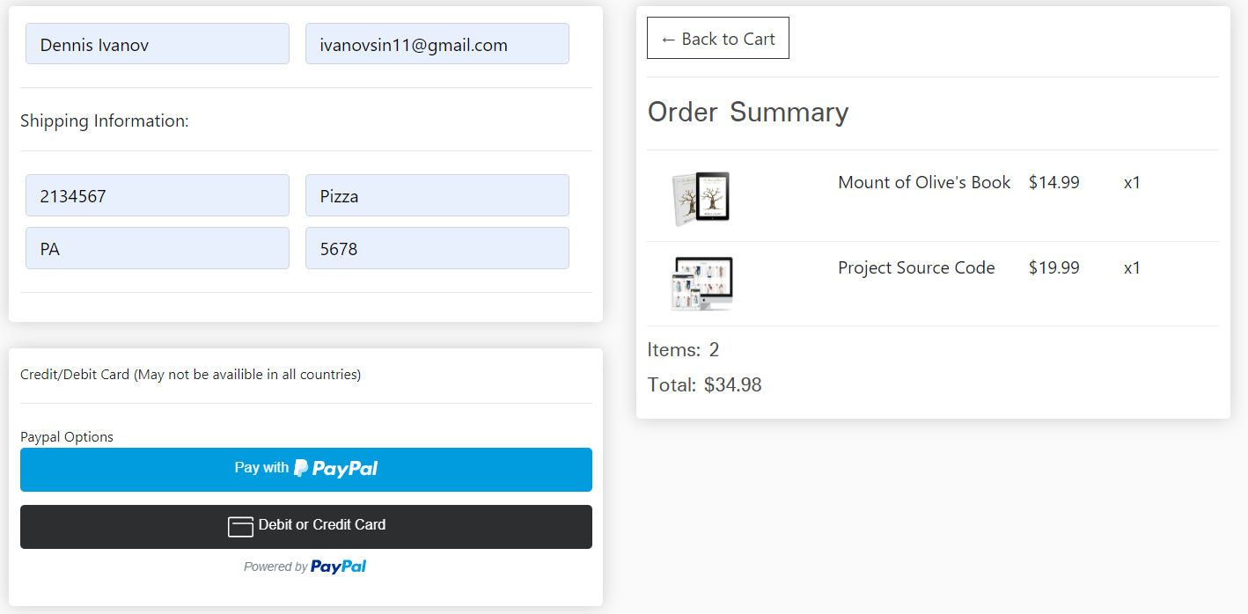
Paypal Integration
Payment integration will be handled with PayPal offering the ability to checkout with a PayPal account and checkout with PayPal debit/credit card. Stripe integration is simple to add but for the purpose of international transactions we will focus on PayPal for international availability and security.

Slide 7
Modules
• Customer
(Authenticated Guest)
-Add to cart
-Update cart
-Checkout
(Unauthenticated Guest)
- Add to cart
- Checkout without ever needing to create an account.
• Payment Module
-PayPal will give the user the ability to do quick checkout using their PayPal account OR Credit/Debit card.
• Cart Module
- Its stores the count and Product info from user.
• Checkout Module
-Retrieve data from database and show it to the customer to proceed further.

Slide 8
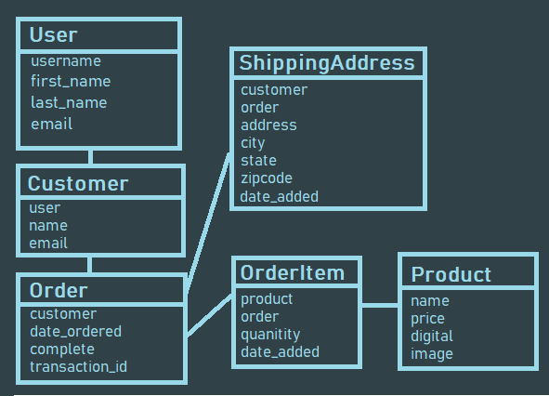
Models

Slide 9
This project will consist of 6 Models, so let's summarize each one:
1. USER - Built in Django user model, instance created for each customer who registers.
2. CUSTOMER - Along with a User model, each customer will contain a Customer model that holds a one to one relationship to each user. (One-To-One Field)
3. PRODUCT - The product model represents product types we have in store.
4. ORDER - The order model will represent a transaction that is placed or pending. The model will hold information such as the transaction ID, data completed and order status. This model will be a child or the customer model but a parent to Order Items.
5. ORDERITEM - An order Item is one item with an order. For example, a shopping cart may consist of many items but is all part of one order. Therefore the OrderItem model will be a child of the PRODUCT model AND the ORDER Model.
6. SHIPPING - Not every order will need shipping information. For orders containing physical products that need to be shipping we will need to create an instance of the shipping model to know where to send the order. Shipping will simply be a child of the order model when necessary.

Slide 10
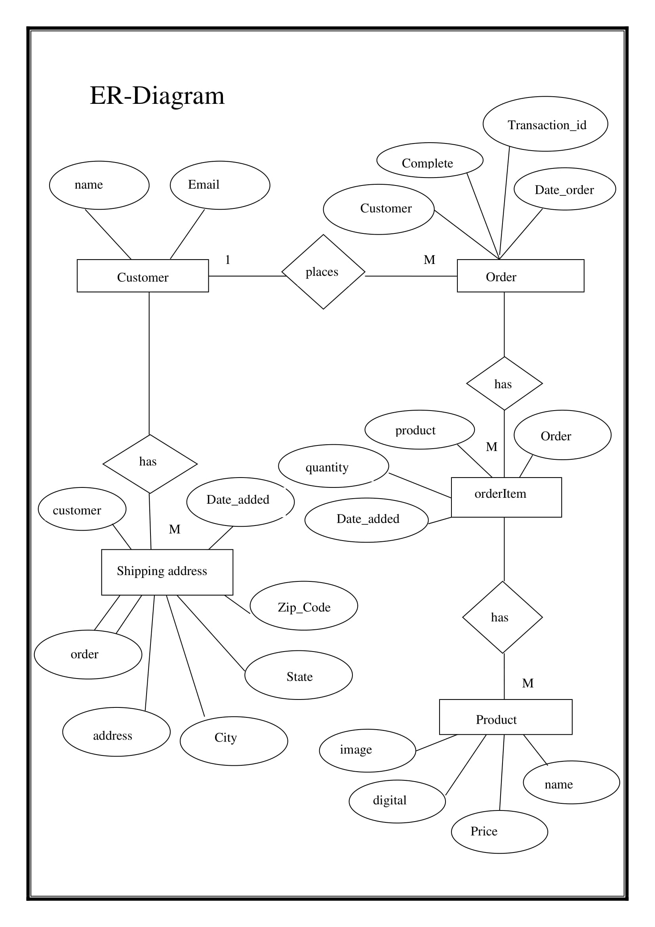

Slide 11
Advantages
Unique database of customer
Store and product listing creation
Online payment mode
Faster buying process
Cost reduction
Flexibility for customer
Affordable advertising and marketing
Faster response to buyer/market demands

Slide 12
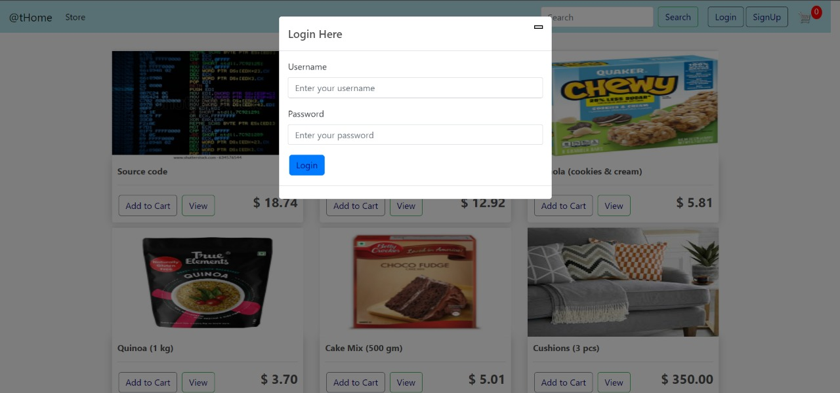
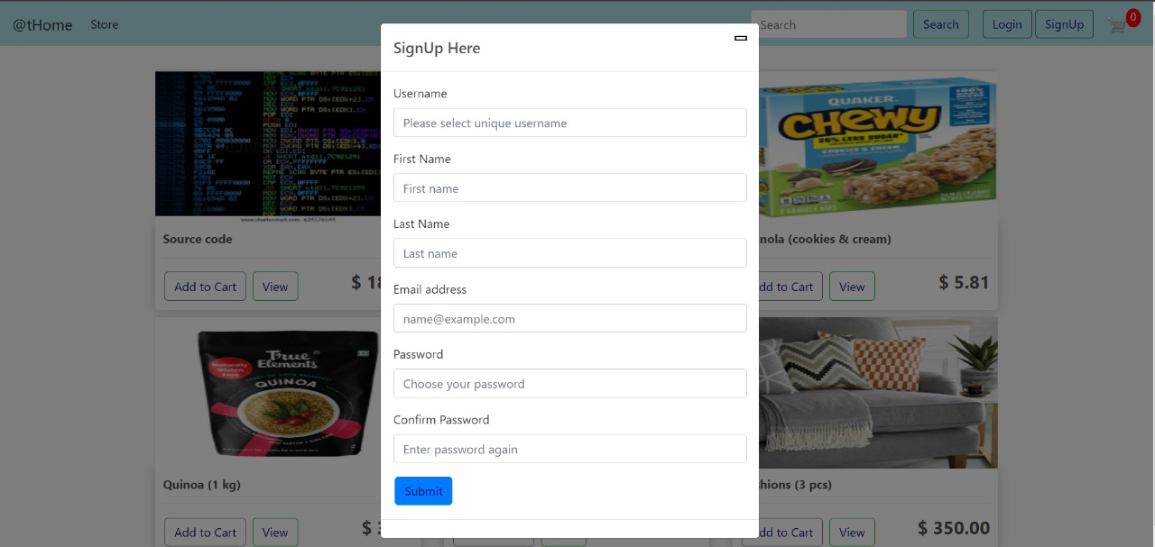
Output screens

Slide 13
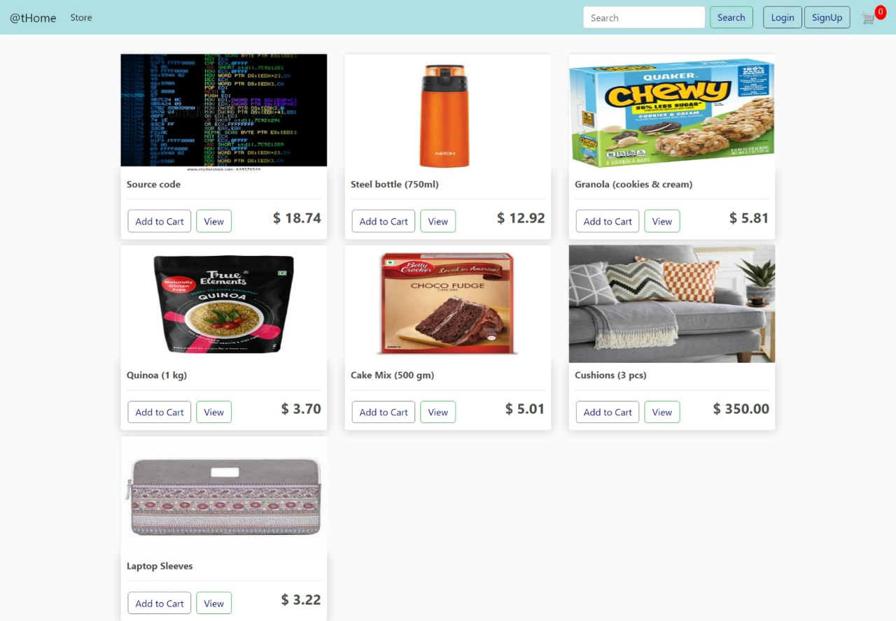
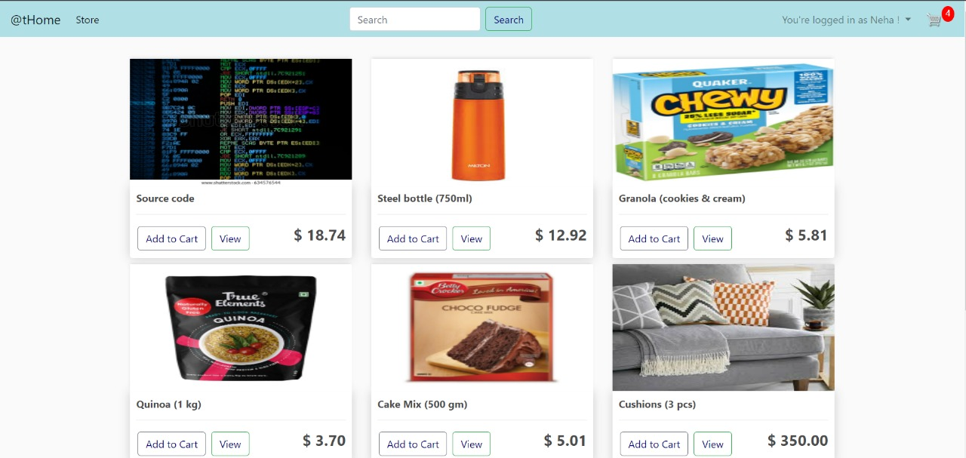

Slide 14
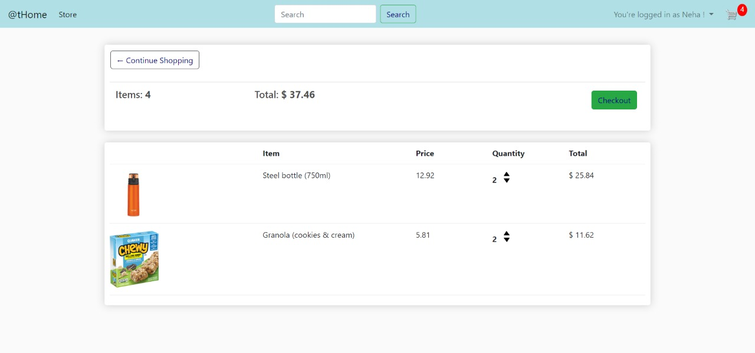
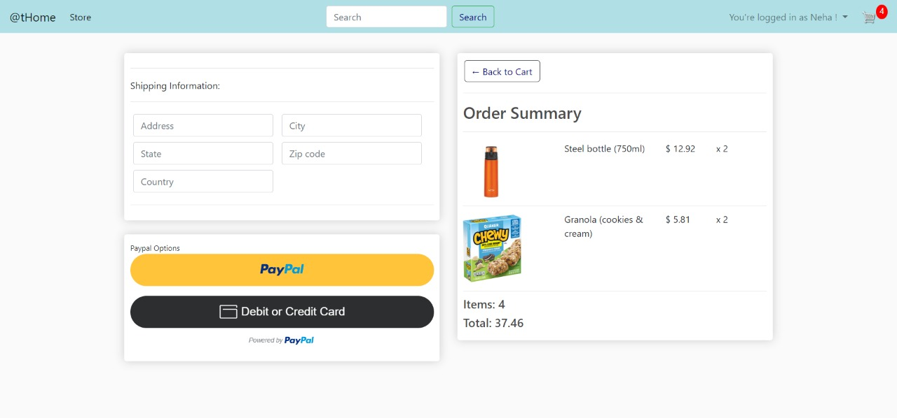

Slide 15
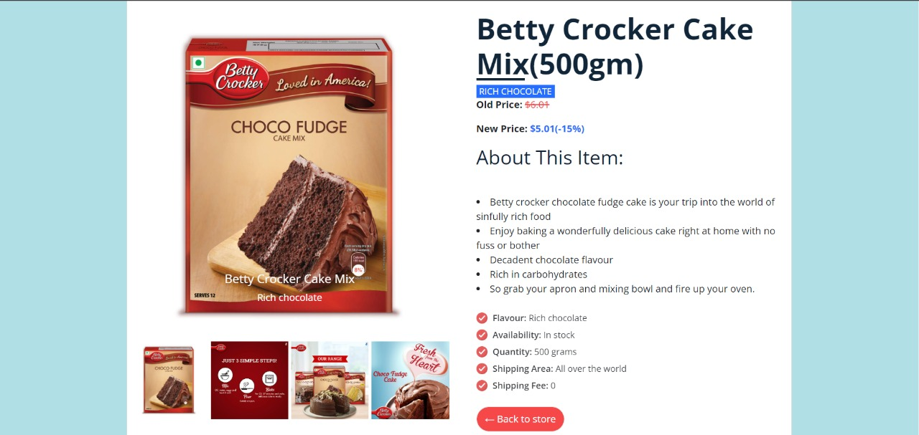
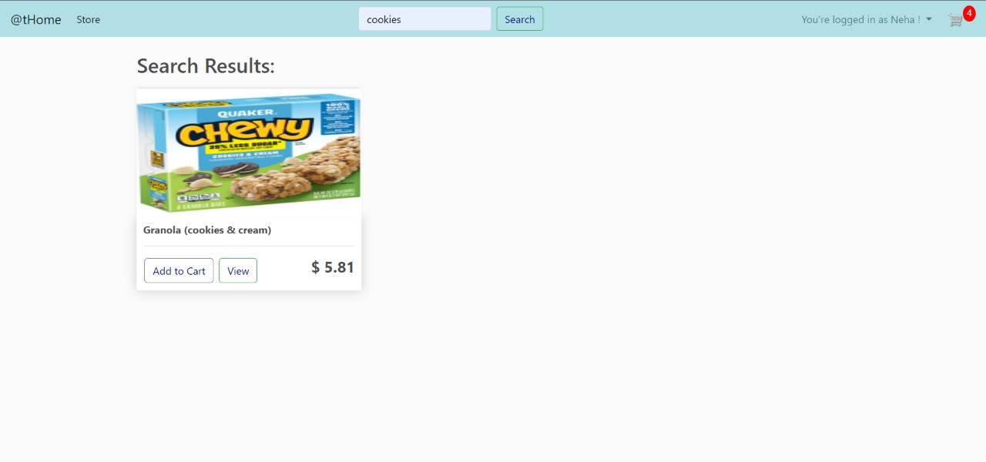

Slide 16
Future enhancements
Tracking of the user’s order history
Billing confirmation on email
Sorting according to categories
Coupons during checkout

Slide 17
Thank You

